Slide 1

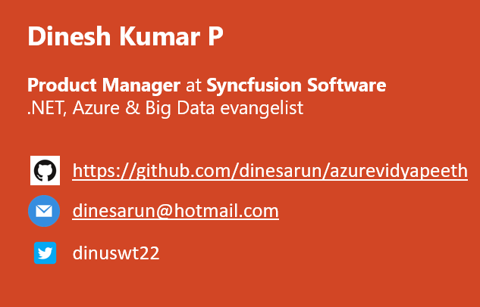
Big Data & Azure
Notes:
Good afternoon guys. Ya. I am Dinesh Kumar. Product Manager at Syncfusion Software. I manage ‘Data sources’ division of Data Platform team. And I am pretty happy to present this Webinar in Azure Vidyapeeth to this wonderful audience. Here we go!

Slide 2
Agenda
Big Data project life cycle
Big Data & Cloud
Demo with
Apache Hadoop +
Apache Spark +
Azure Blob

Slide 3
Why BigData
Cost reduction.
Hybrid storage options,
Mostly used – SQL Server
Rarely used like logs – Azure Blob
AI , Analytics, Cloud are also in picture of Big Data.
Empowers management to make better decisions analyzing more about their work.
Notes:
Cost reduction - Big data technologies such as Hadoop and cloud-based analytics bring significant cost advantages when it comes to storing large amounts of data.

Slide 4
Domains, Industries
Marketing
Sales and CRM
Web Analytics
Ecommerce
Advertising
IT
Finance
Healthcare
Social Media
SEO
Banking
Human Resources
Mobile Analytics
Project Management
Research and Development
Support
Survey
Insurance
Manufacturing
Energy
Oil & Gas
Pharmaceuticals
Public Sector
Retail
Communications
Food and Beverages
Education
Media
Technology
Transportation and Logistics
Notes:
Different domains now a days produces different KINDS of data. Upon which all cannot be fit into traditional SQL based database systems.

Slide 5

Why does my company think about Big Data?
Every enterprise started to understand big data, data science,
Does the company value data?
Does the company recognize the potential of data-driven marketing?
Does company ready to take decision based on data?

Slide 6

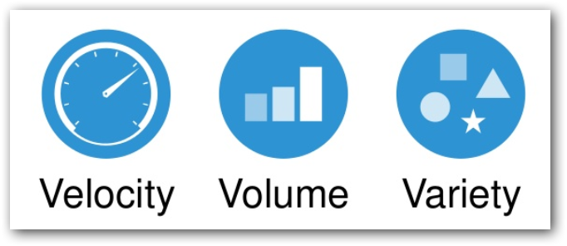
So Big Data is,
Store, Process, Visualize
4th V
Veracity
Notes:
Volume – data storage size and rate of change,
Variety – structured, multi-structured,
Complexity of the analytical processing involved, query complexity, mixed query workload, data schema complexity, need for concurrent data loading, need for near-real-time results, batch or interactive processing, and so forth...

Slide 7
Different paths
Data Scientist
Data Analyst
ML Engineer
Data Admin
Data Engineer

Slide 8
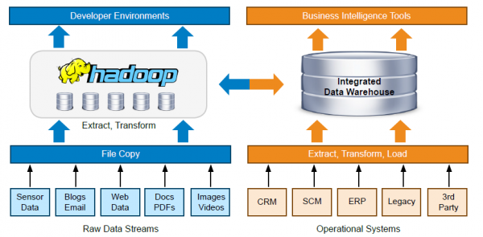

Slide 9

How Big Data? Project life cycle
2. Identify source(s) of Data
4. Storage & Access
5. Processing
6. Visualization
3. Data Integration
1. Defining Objective

Slide 10
1. Defining Objective
Understand the domain & industry,
Discuss about the business need / problem,
Prepare the objectives.

Slide 11
2. Data source(s) identification
Find out from where you need to get the data for your project,
Logs
Databases
APIs
Web Servers
Social Media
…

Slide 12
3. Data Integration
Required data would exist in different sources those need to be brought to one place,
Gather
Clean
Prepare
Tools
Azure Data Factory
Informatica
Apache Nifi…

Slide 13
4. Storage & Access
Stages
Initial
Processing
Final
Instances & Services
Cloud Database instances (SQL Server, MySQL,..)
Azure Blob
Azure Data Lake
Access
API
Integration between processing tool

Slide 14
5. Process
Perform Analytics
ML models
Map Reduce
Tools & Services
Azure HDInsight
Azure Databricks

Slide 15
6. Visualize
BI tools for business decisions
PowerBI
Syncfusion Dashboard

Slide 16

Cloud & Big Data
Dynamic scalability.
Cluster? -> Environment.
Go with perfectly sized cluster when needed, while not inducing any costs when not needed.
Famous vendors,
Microsoft Azure,
Amazon Web Services,
Google Cloud Platform
Cloud database options

Slide 17
Azure Blob
Store any kind of files
Access Tiers – Hot & Cool
Scalable storage space for unstructured data
Multiple ways of Accessing data
And other benefits as well,
Redundancy
Consistency
Notes:
Redundancy – Geo Replica
Consistency – 1 change reflect everywhere

Slide 18




Enter Text
Questions ?
https://github.com/dinesarun/azurevidyapeeth
dinesarun@hotmail.com
dinuswt22

